Slide 1


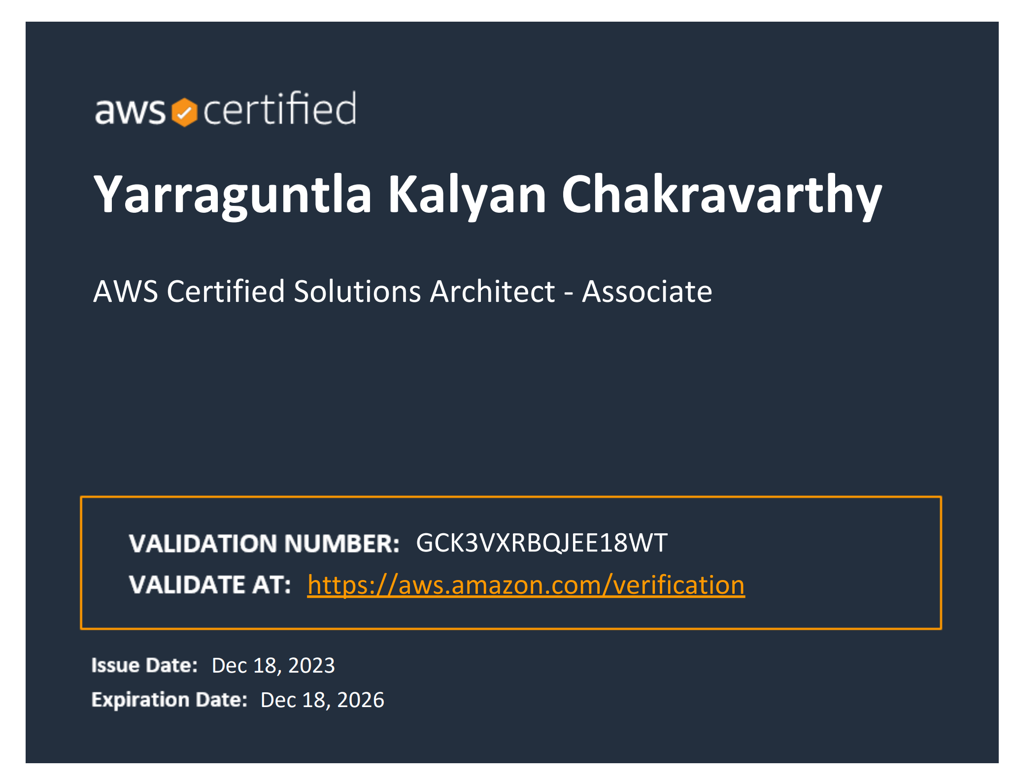
Online Learning Management System (LMS)
Title of your Presentation
Yarraguntla Kalyan Chakravarthy
(21BAI1759)
29-11-2023
-GLOBAL COURSE

Slide 2
AWS
Amazon Web Services (AWS) is the world's most comprehensive and broadly adopted cloud platform, offering over 200 fully featured services from data centers globally.(AWS) Certification validates cloud expertise to help professionals highlight in-demand skills and organizations build effective, innovative teams for cloud initiatives using AWS.
AWS is designed to allow application providers, ISVs, and vendors to quickly and securely host your applications – whether an existing application or a new SaaS-based application. You can use the AWS Management Console or well-documented web services APIs to access AWS's application hosting platform

Slide 3
Introduction
Project Description:
With the rise of e-learning, there is a need for a comprehensive online platform that can deliver educational content to a wide range of learners. This platform should support various content formats, track learner progress, and provide interactive tools to enhance the learning experience. It must be scalable to accommodate a growing number of users and a broad catalog of courses.
Objectives:
Develop an intuitive interface for learners and educators.
Support live sessions and on-demand content delivery.
Offer assessment and certification capabilities for courses.

Slide 4
Project Scope
Course Management: Instructors will be able to create, manage, and deliver courses. This includes uploading course materials, conduct quizzes , and grading student work.
Student Management: Students will be able to create accounts, enroll in courses, and access course materials. Students will also be able to take quizzes.
Content Management: The LMS will support a variety of content formats, including text, images, videos, and audio.
Communication and Collaboration: The LMS will include features for communication and collaboration, such as forums, chat rooms.
Assessment and Tracking: The LMS will include tools for assessing student progress and performance. This includes quizzes, and books.

Slide 5
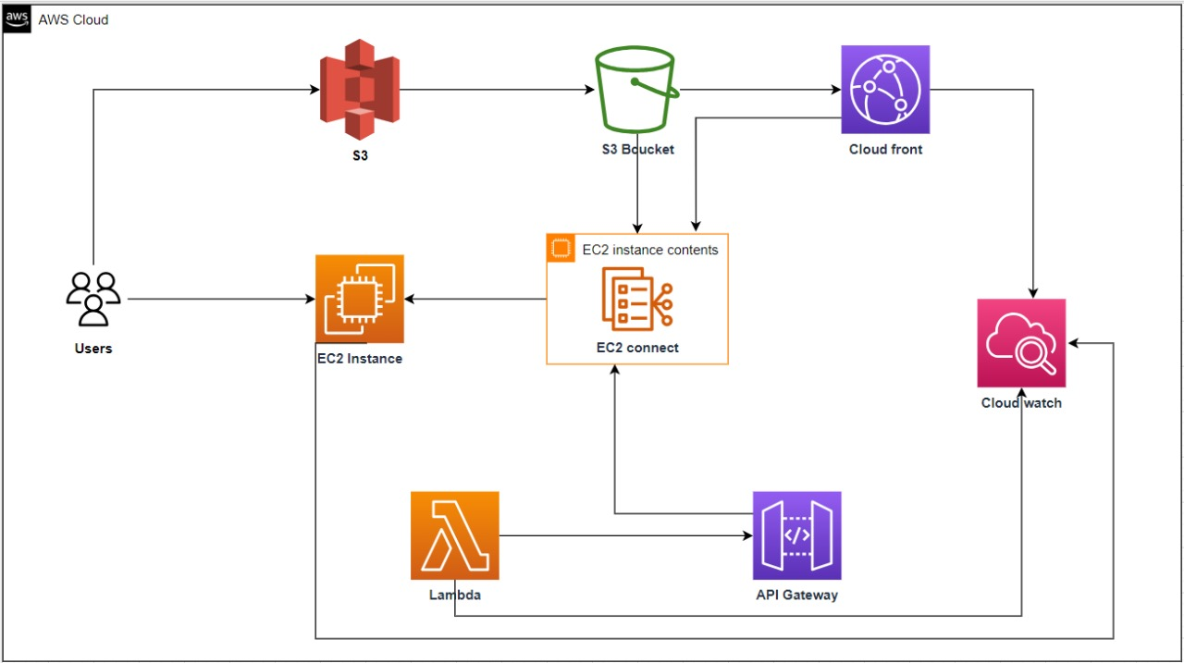
Project Architecture
The AWS architecture makes it possible to offer the best services to clients based on web services technologies, adding or removing virtual servers, the selection of services, etc. AWS services and resources are available worldwide 24/7 and 365 days of the year where solutions are easily deployed according to clients’ requirements.
AWS Services:
Amazon EC2
S3
Lambda
API Gateway
CloudFront
Cloud Watch

Slide 6
Interaction: How these services work together.
As our project needed the multi media content we uploaded the content of the courses like video's and materials in the S3 bucket created. As we need to play the content video's with low latency. So, we added video's from S3 bucket to cloud front. Now we generated the links for the video's from the cloud front and links for the materials from the S3 bucket. The links that we collected from s3 and cloudfront have been attached to the html files so that it can be easily redirected. In our project we need to conduct the skill assessment for our courses so we need backend process to be done. For the backend process we created lambda functions to generate the marks. Once we done with our lambda part we created API gateway and got the API gateway link so that we can connect our frontend and backend part. Once we completed our frontend part(HTML, CSS, JavaScript), we uploaded all the code files in EC2 instance and launched a website. And last but not the least we created cloud watch to monitor the system and provide the analytics.

Slide 7
Key Concepts
Features: EC2 Connect, API Gateways
Services:
Amazon EC2: Host the LMS application.
Amazon S3: Store and distribute multimedia learning content.
AWS Lambda: Automate backend processes.
Amazon CloudFront: Deliver content with low latency.
Amazon CloudWatch: Monitor the system and provide analytics.
API Gateway: For connecting frontend and backend.

Slide 8
Challenges and Solutions
Problem 1: Connecting my html code to the backend lambda function code.
Solution1: Creating the API Gateway and giving the link in the html page.
Problem2: Hosting my web page with EC2
Solution2: In my labs I used to write html code in user data but there are too many pages so we used Ec2 connect to host the website.

Slide 9
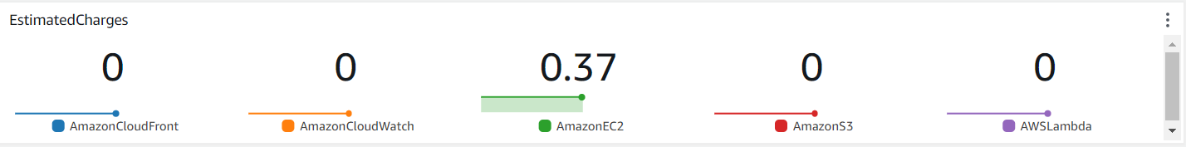
Cost Analysis
Cost Breakdown: Summary of AWS costs.
Total cost for AWS costs is 2.1 dollars.
Budgeting: How costs were managed or optimized.
By stopping the EC2 instance when it is not necessary.

Slide 10
Security Measures
Authentication:
Students profile and progress of contents will only available with educators.
Data Protection:
Secure Storage of files in S3
Conduct privacy impact assessments

Slide 11
Lessons Learned
Technical Insights:
Connecting backend and frontend using API Gateway.
For low latency, linking S3 with CloudFront.
Hosting the website using EC2.
Process Insights:
Communication skills
Time Management
Task distribution

Slide 12
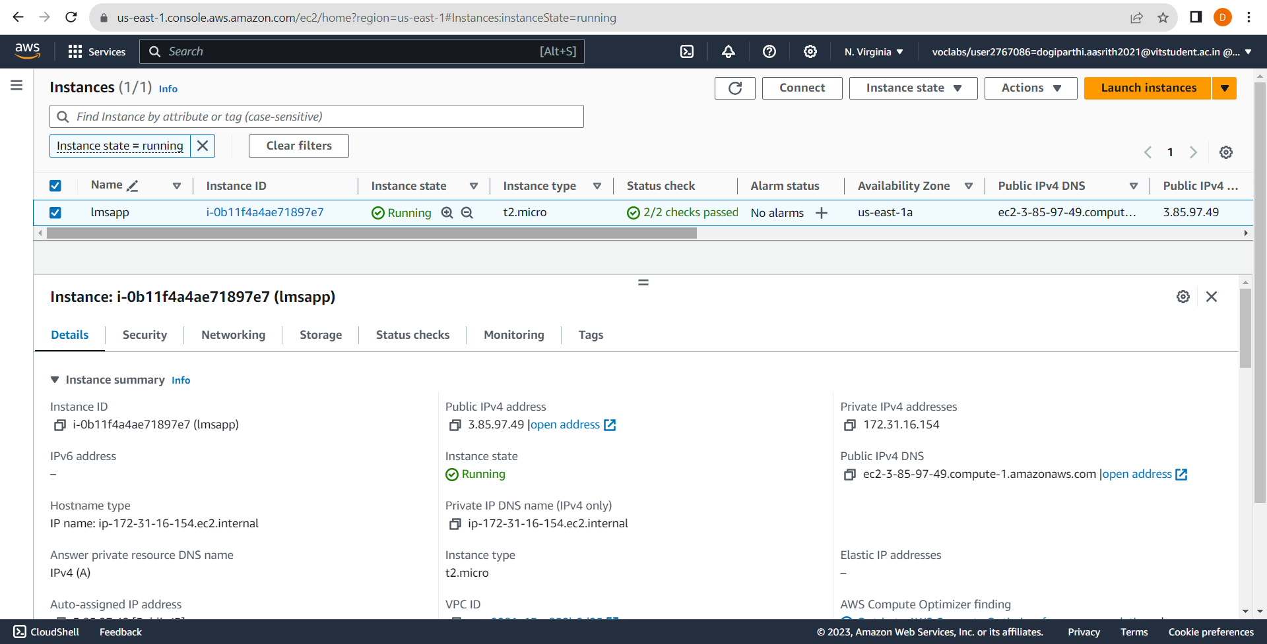
Visual snapshots
EC2
Creating the instance.
By using EC2 connect hosting the website.

Slide 13
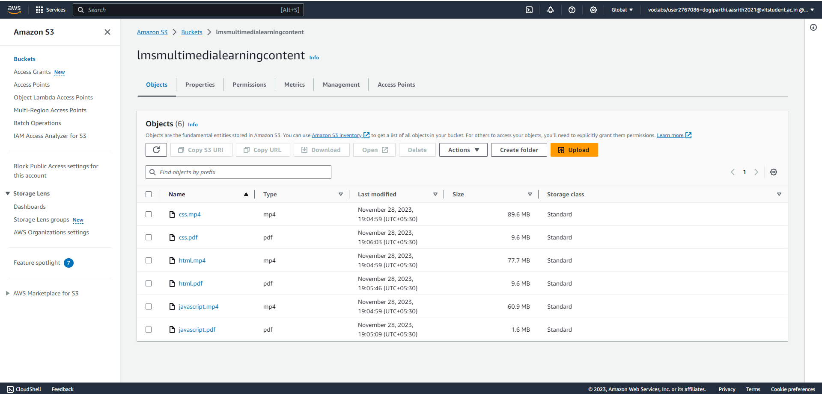
Visual snapshots
S3
Creating the bucket.
uploading the files to the bucket and making it public access.

Slide 14
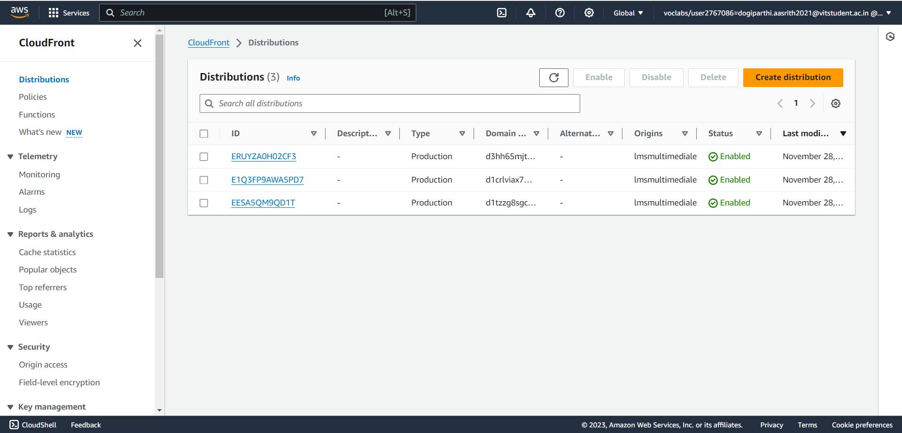
Visual snapshots
CloudFront
Creating the distribution and moving the videos from S3 to cloudfront
For low latency.

Slide 15
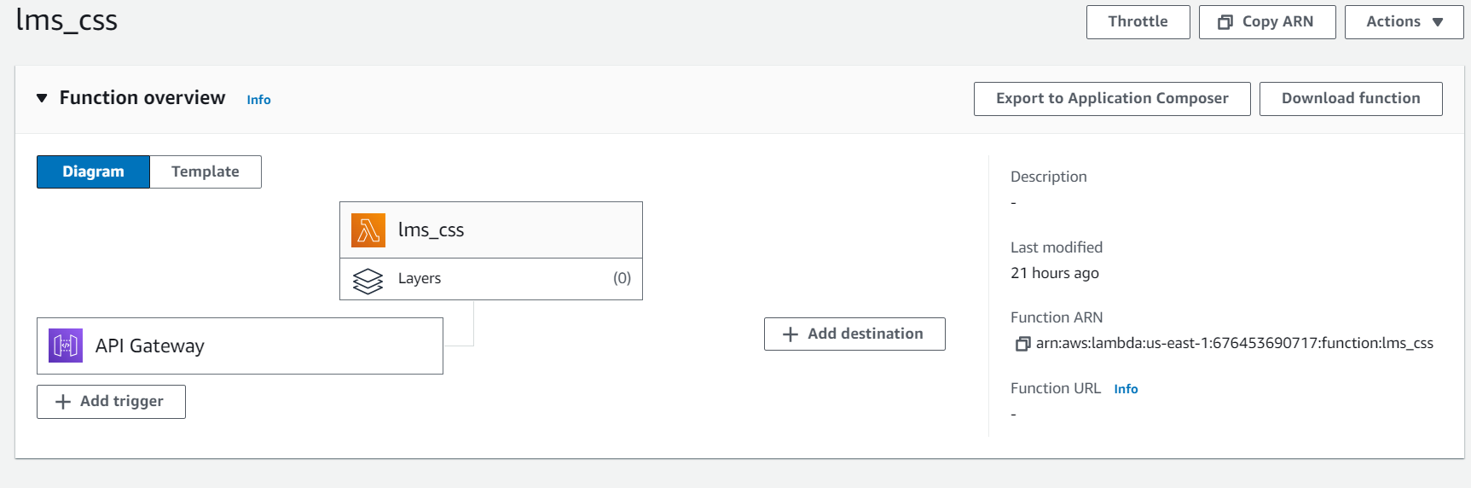
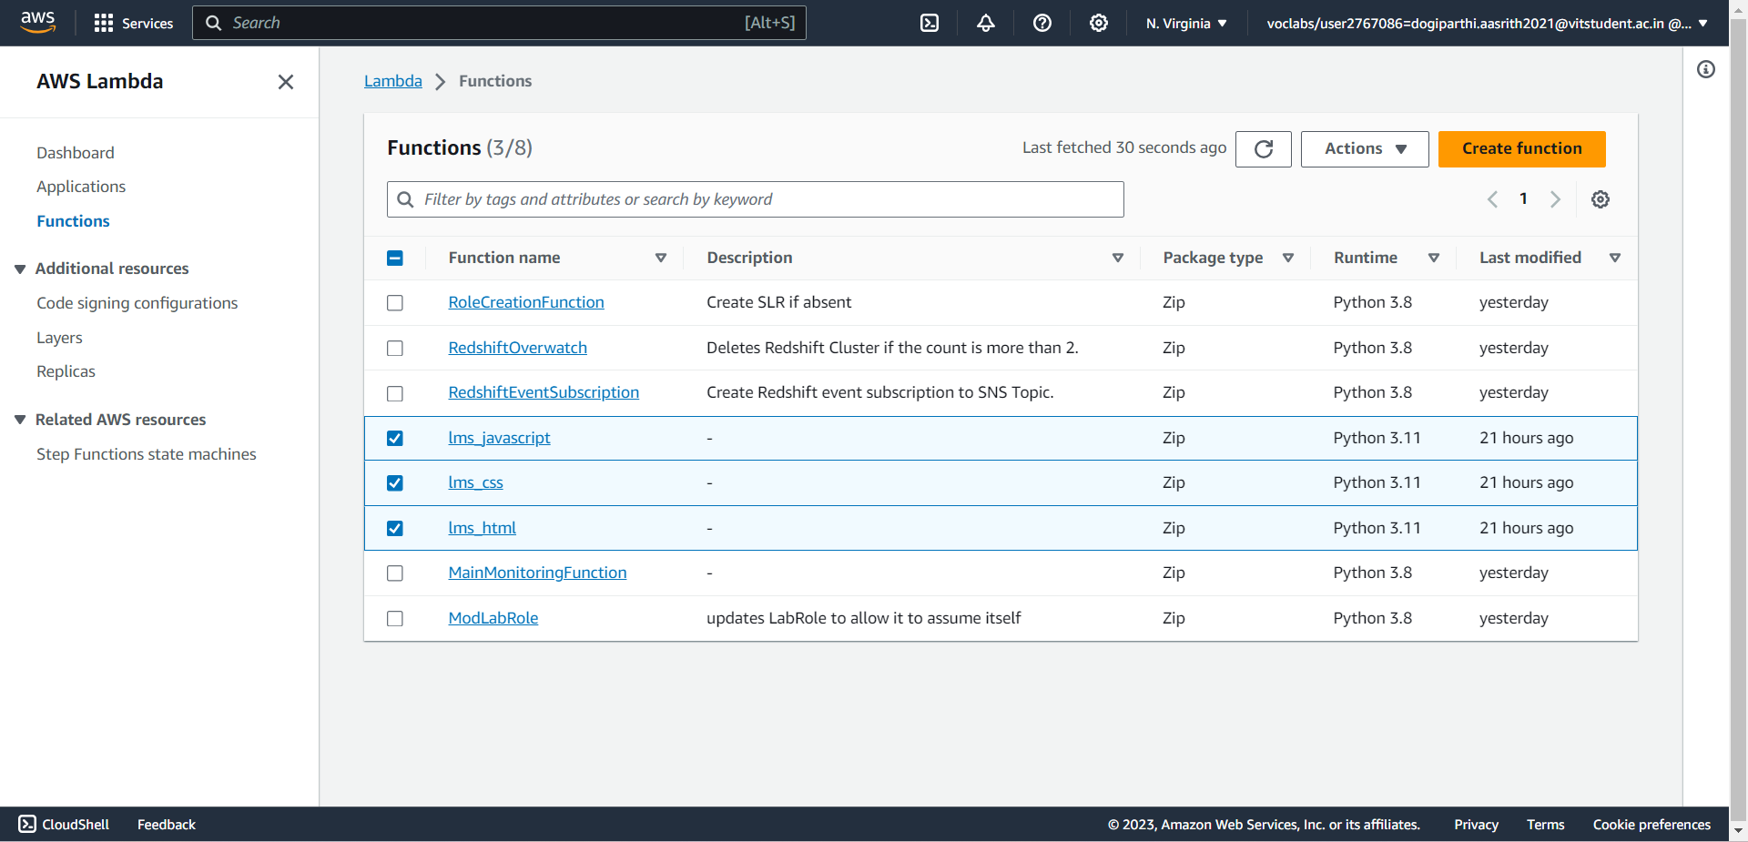
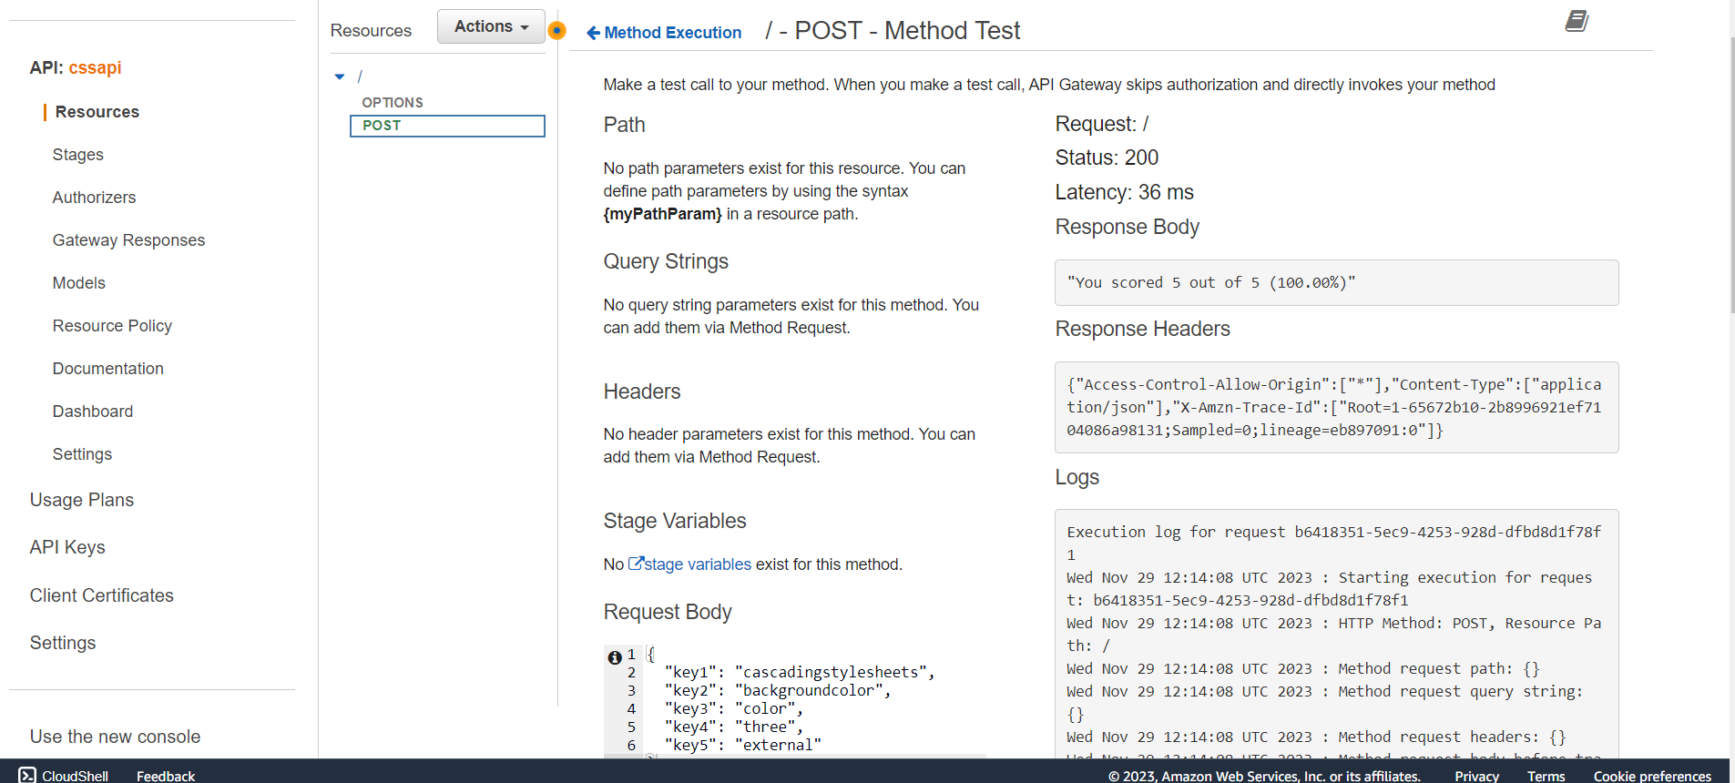
Visual snapshots
Lambda and API Gateway
Creating the three functions for backend process.
Connecting lambda to API Gateway and API Gateway to frontend.

Slide 16
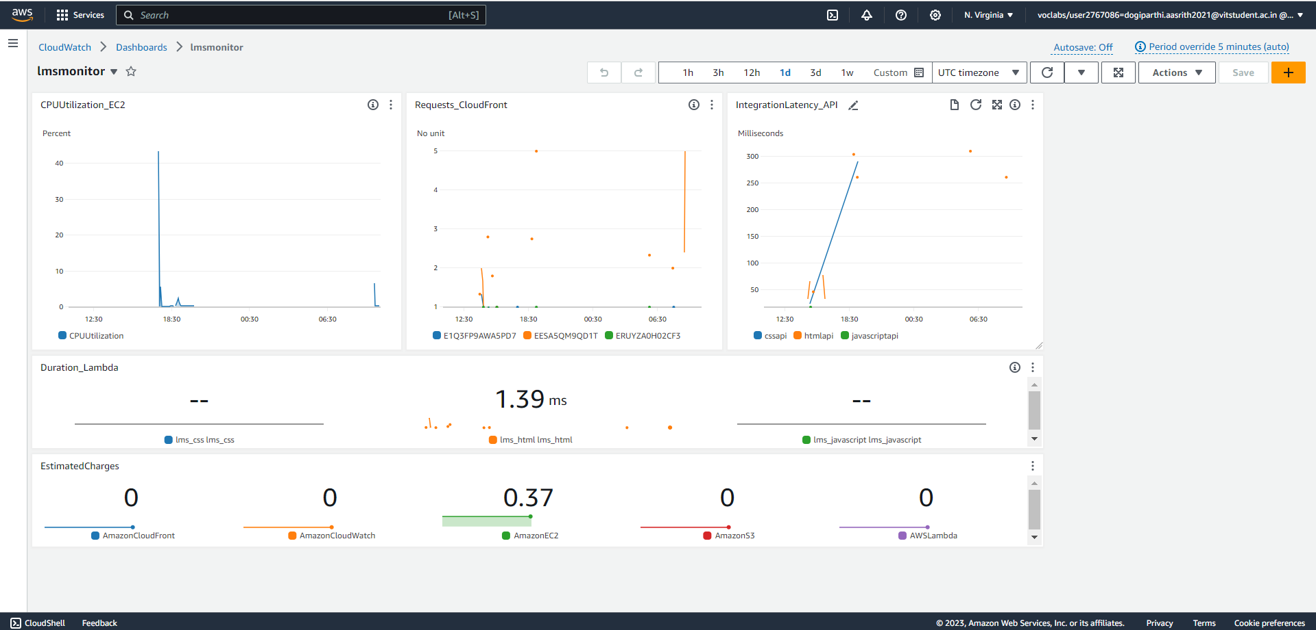
Visual snapshots
CloudWatch
Creating a dashboard for monitoring AWS services

Slide 17
Conclusion
Cloud computing has enabled ease in conducting businesses and delivering services. It has also promoted the growth of Small and Medium Enterprises in great proportions. AWS proves to be the best in offering cloud-computing services for individuals, organizations and many business entities. It is very eﬃcient and cost effective as compared to its competitors. Provision of these services affordably makes Amazon Web Services more popular and leads in the service globally.
However, Small and Medium Enterprises observe a greater sense of security with Amazon Web Services in addition to its affordability. As a result, AWS is a preferable option for all new and up-coming companies

Slide 18


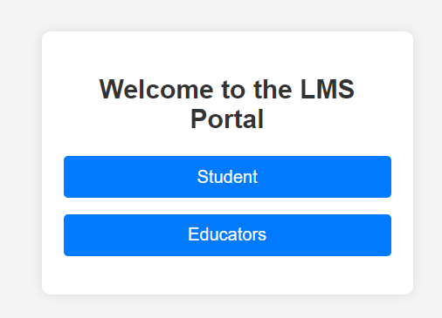
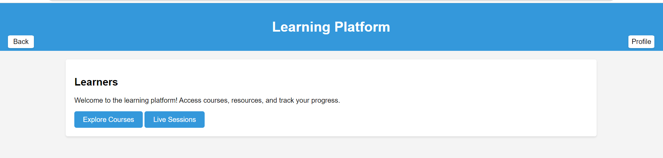
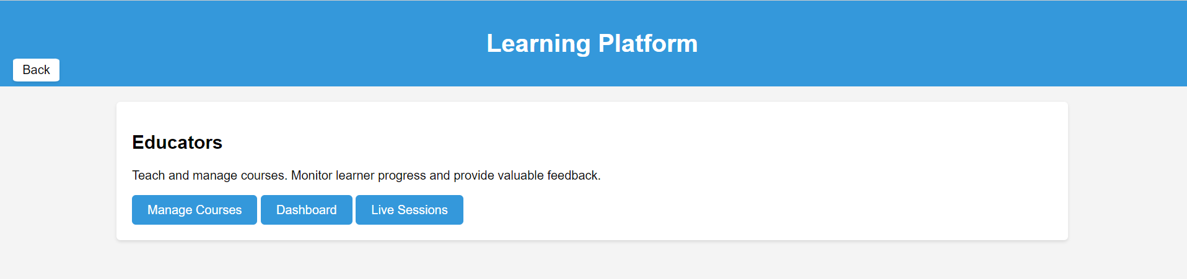
Screenshots
Here goes the subtitle of your section
Project Name 18

Slide 19
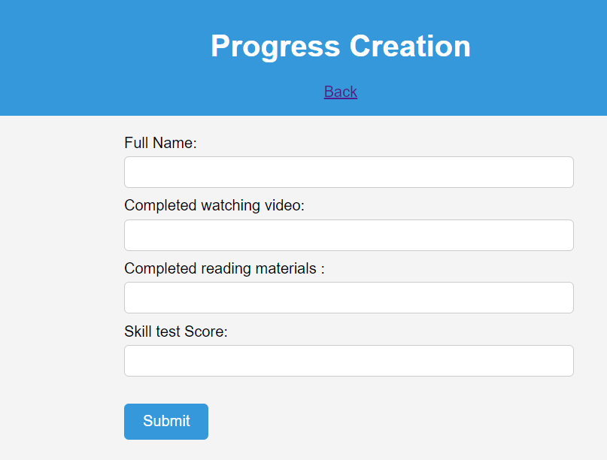
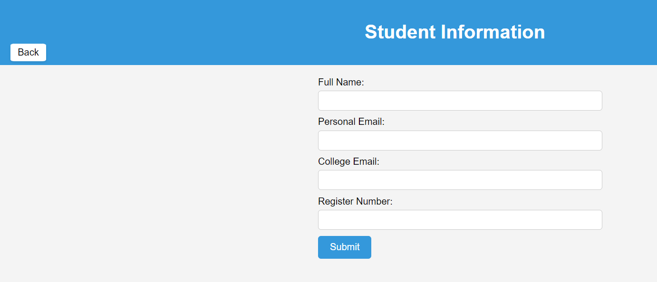
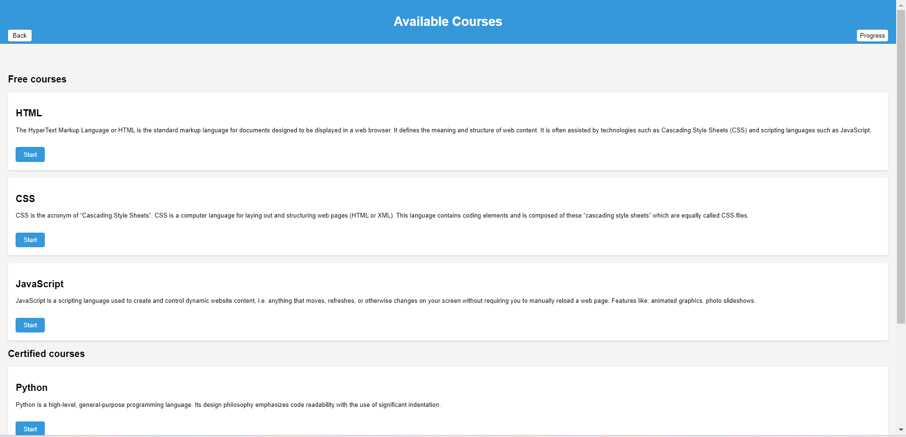
Screenshots Students Page
19

Slide 20
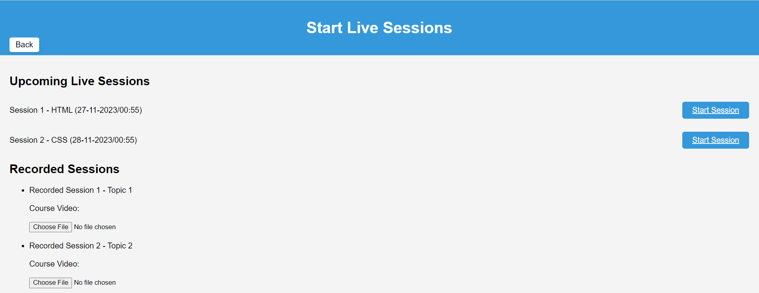
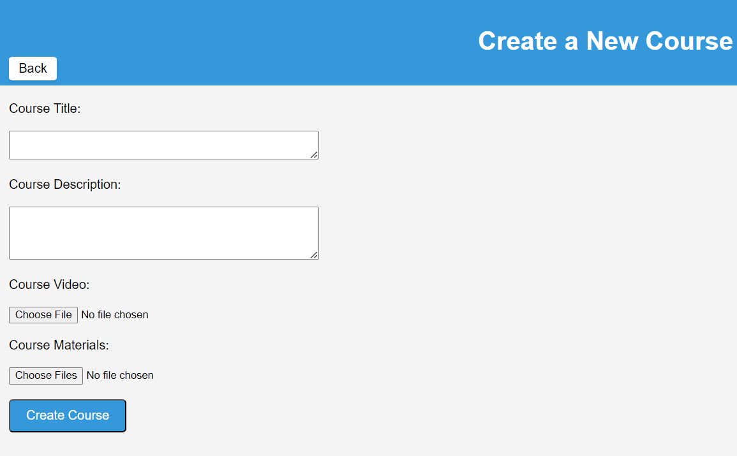
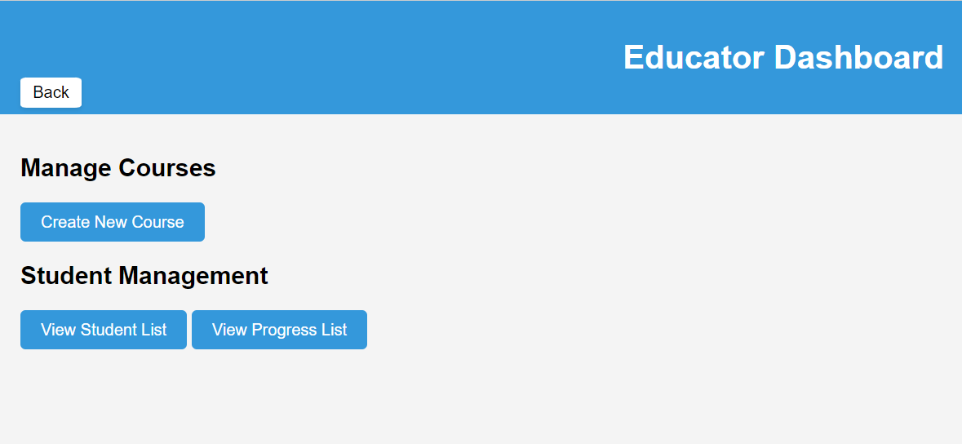
Screenshots Educators Page

Slide 21
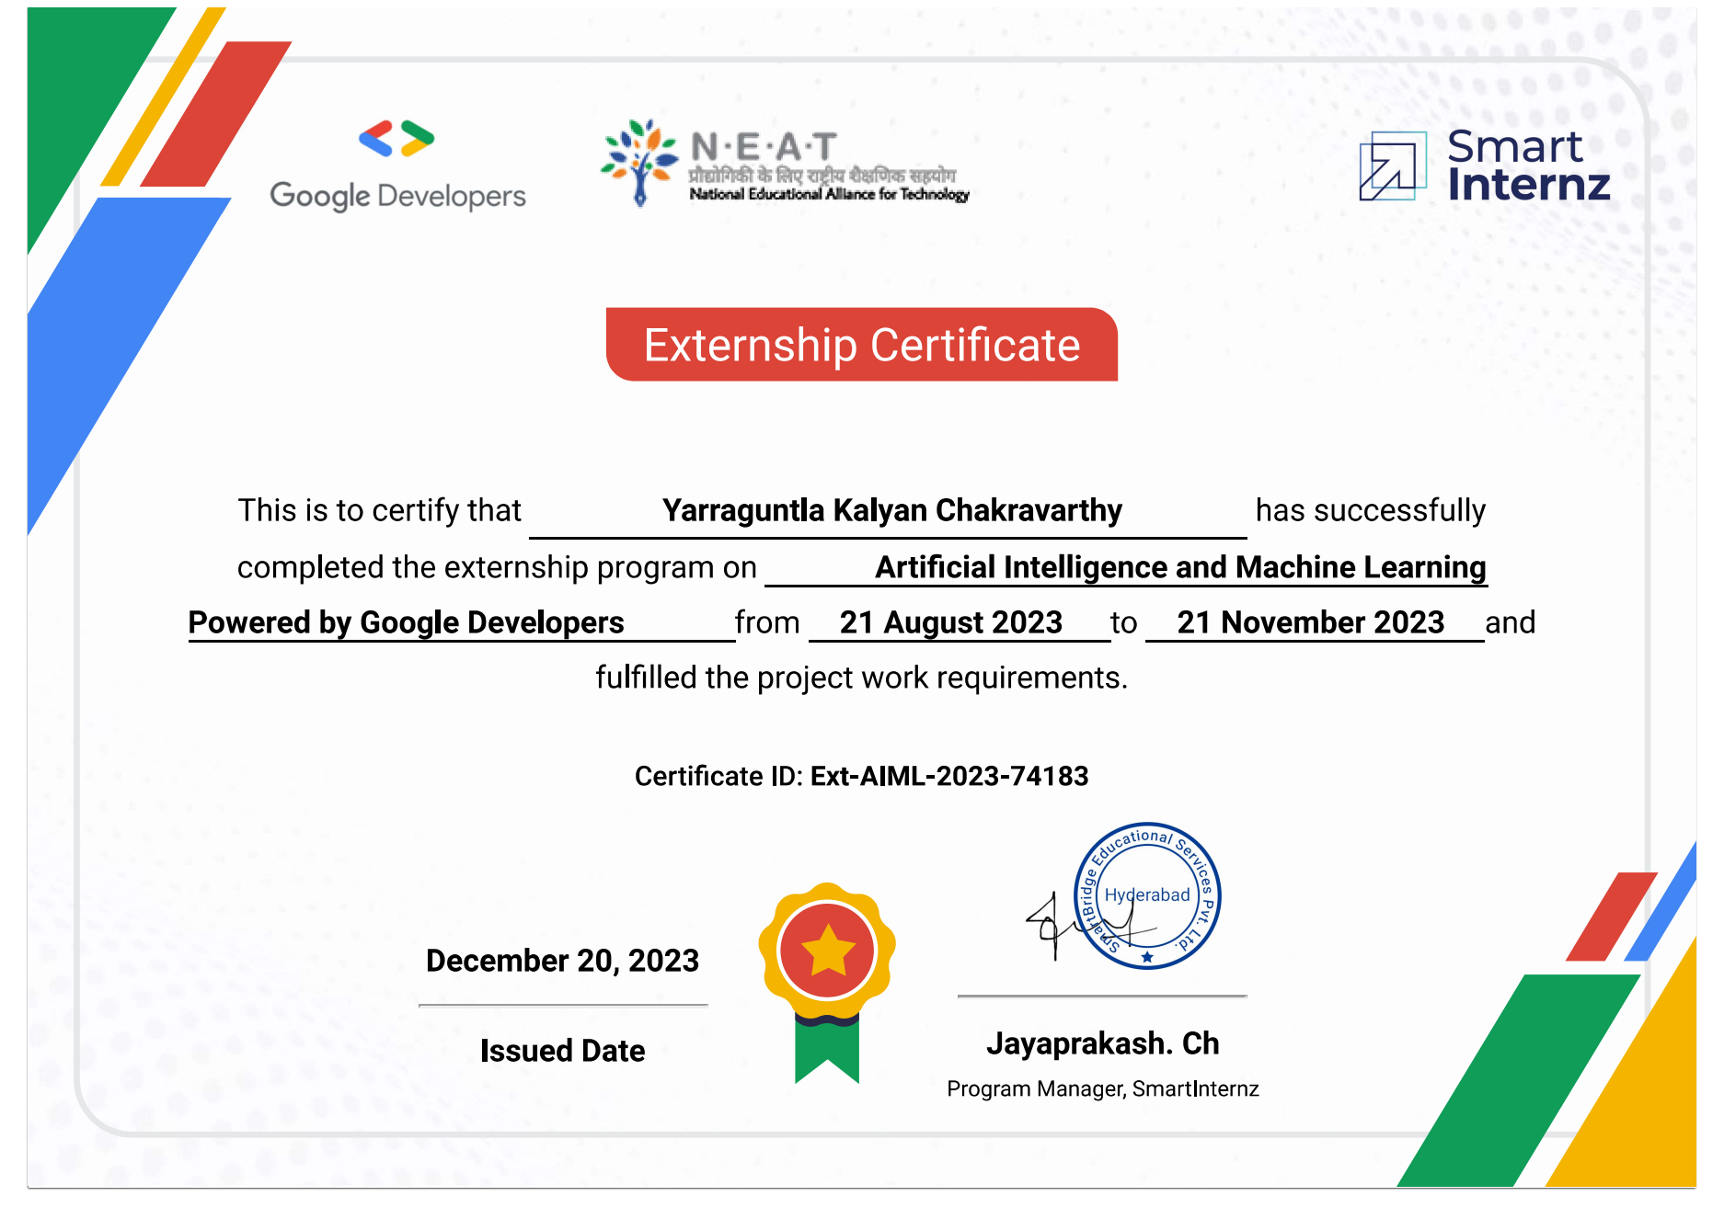
Potato Leaf Disease Classification
Kalyan Chakravarthy
(21BAI1759)
fOUNDATION
Notes:
NOTE: To change images on this slide, select a picture and delete it. Then click the Insert Picture icon
in the placeholder to insert your own image.

Slide 22
Introduction
The cultivation of potatoes is a crucial global agricultural activity, vital for food security and economic stability. However, potato plants are susceptible to various diseases, posing significant threats to crop yield and quality. To address this challenge, we propose the development of a system utilizing Convolutional Neural Networks (CNN) and deep learning techniques to accurately classify potato diseases, aiding farmers in timely disease management decisions. Early detection of potato leaf diseases is paramount, as it enables farmers to mitigate crop loss, minimize costs associated with disease control measures, reduce environmental impact by targeting affected areas with precision, and enhance overall crop quality through timely interventions. By predicting these diseases promptly, farmers can take proactive steps to prevent their spread, ensuring sustainable potato cultivation practices and safeguarding agricultural productivity.
Notes:
NOTE: To change images on this slide, select a picture and delete it. Then click the Insert Picture icon
in the placeholder to insert your own image.

Slide 23
LITERATURE SURVEY
Numerous studies have demonstrated the efficacy of deep learning techniques, particularly Convolutional Neural Networks (CNNs), in classifying plant diseases, including those affecting potatoes. Transfer learning from pretrained models such as VGG19, ResNet50, and Inception has proven highly accurate in identifying various plant diseases, emphasizing the importance of large, diverse datasets and data augmentation strategies for robust model development. Existing datasets like the Plant Village dataset have been instrumental, with researchers employing preprocessing techniques and domain-specific augmentation methods to address challenges like imbalanced class distribution and lighting variations. Moreover, the literature emphasizes the importance of user-friendly deployment interfaces, with discussions on integrating deep learning models into accessible applications for farmers, accessible via mobile, web, or IoT devices. Interpretability and user feedback integration are also highlighted for practical utility in real-world agricultural settings. Overall, the literature provides a robust foundation for developing a potato disease classification system using deep learning, focusing on dataset quality, preprocessing, model architecture, and user-friendly deployment for tangible benefits in agricultural crop management.

Slide 24





End-to-End Solution
Objective: Develop a complete solution from data to predictions.
Goal: Create a seamless system for accurate leaf disease predictions.
User-Friendly Interface
Objective: Implement an easy-to-use web app.
Goal: Make predictions accessible
Accuracy and Reliability
Objective: Achieve high accuracy using various machine learning models.
Goal: Provide reliable predictions for
leaf images

Slide 25
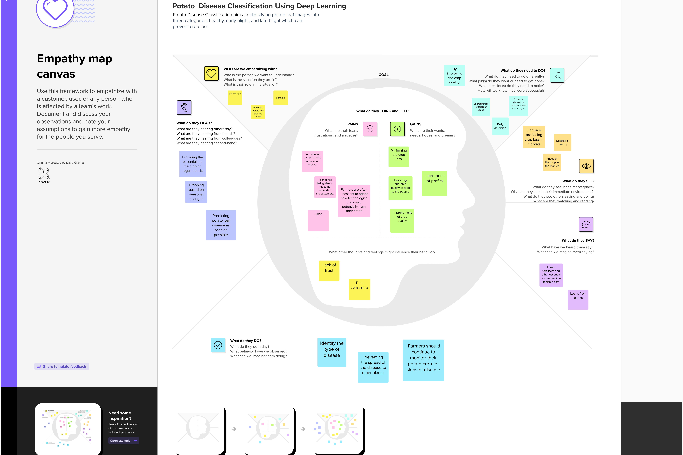
IDEATION &PROPOSED SOLUTION

Slide 26
Requirement Analysis
Functional Requirements:
Image Upload and Processing: Users should be able to upload images of potato plants, which the system will preprocess through resizing and normalization for compatibility with the deep learning model.
Disease Classification: The system must accurately classify potato diseases based on the uploaded images, distinguishing between healthy plants and various disease states while providing specific disease identification for each case.
User Interface: The system should offer a user-friendly interface accessible on multiple devices, providing a straightforward and intuitive experience suitable for users with varying levels of technological proficiency.
Model Interpretability: The system should provide explanations or visualizations of the model's decision-making process, offering insights into why a particular disease classification was made to enhance user trust and understanding.
Scalability and Integration: Ensure the system is scalable and can integrate with other agricultural technologies and information systems, facilitating broader adoption and impact within the agricultural sector.
Non-Functional Requirements:
Performance, Reliability, Security, Usability, and Scalability.

Slide 27
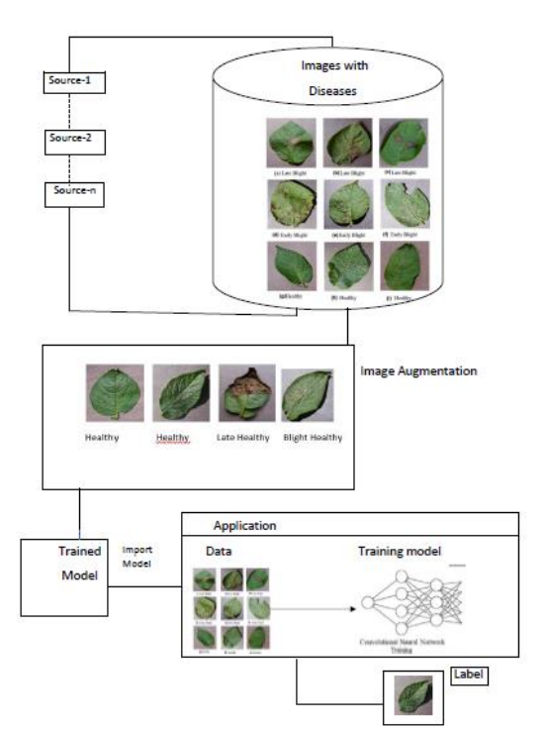
Data Flow Diagram

Slide 28
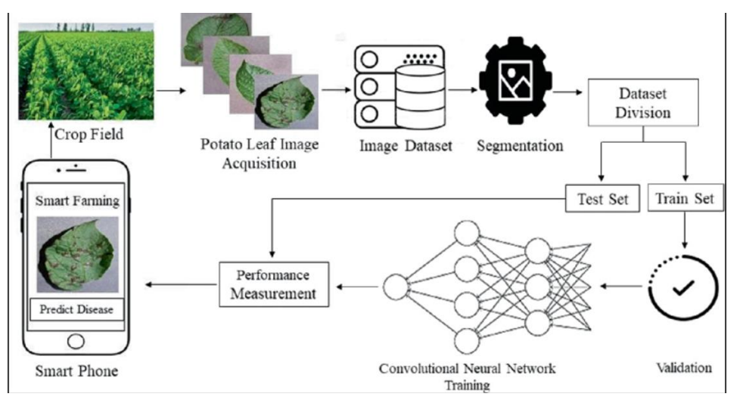
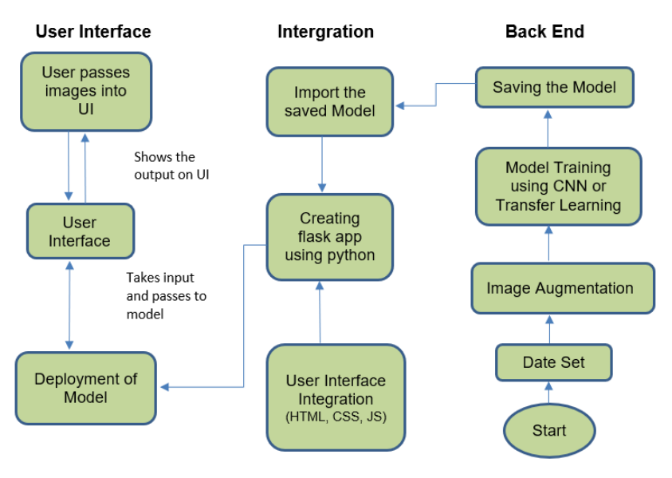
Solution Architecture
Technical Architecture

Slide 29
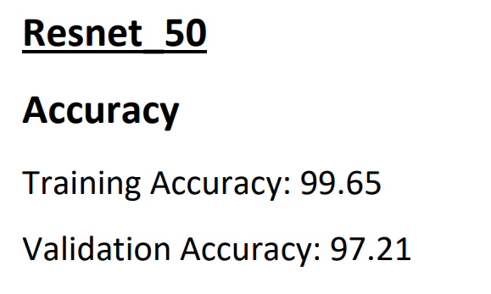
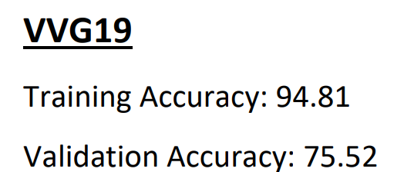
Performance Metrics

Slide 30
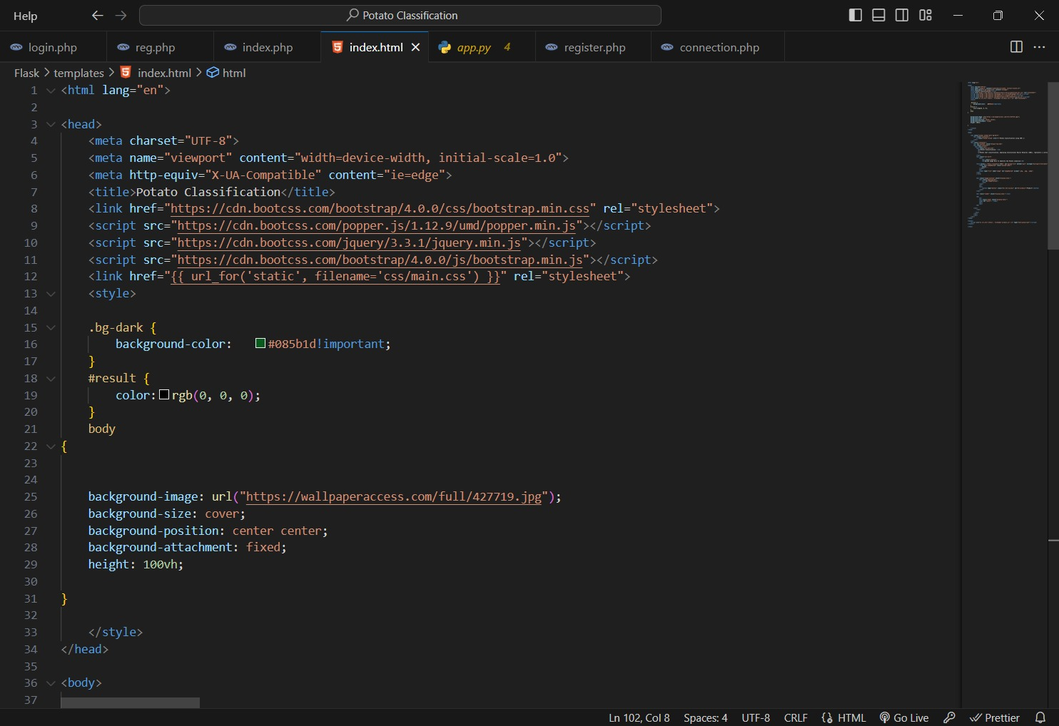
So after completing the prediction of the analysis we are going to implement the model in pkl file using pickel and using flask and socket so we are going to create a server and will link the model to a website such that a website will be created and by giving the required inputs you will get the desired output.

Slide 31
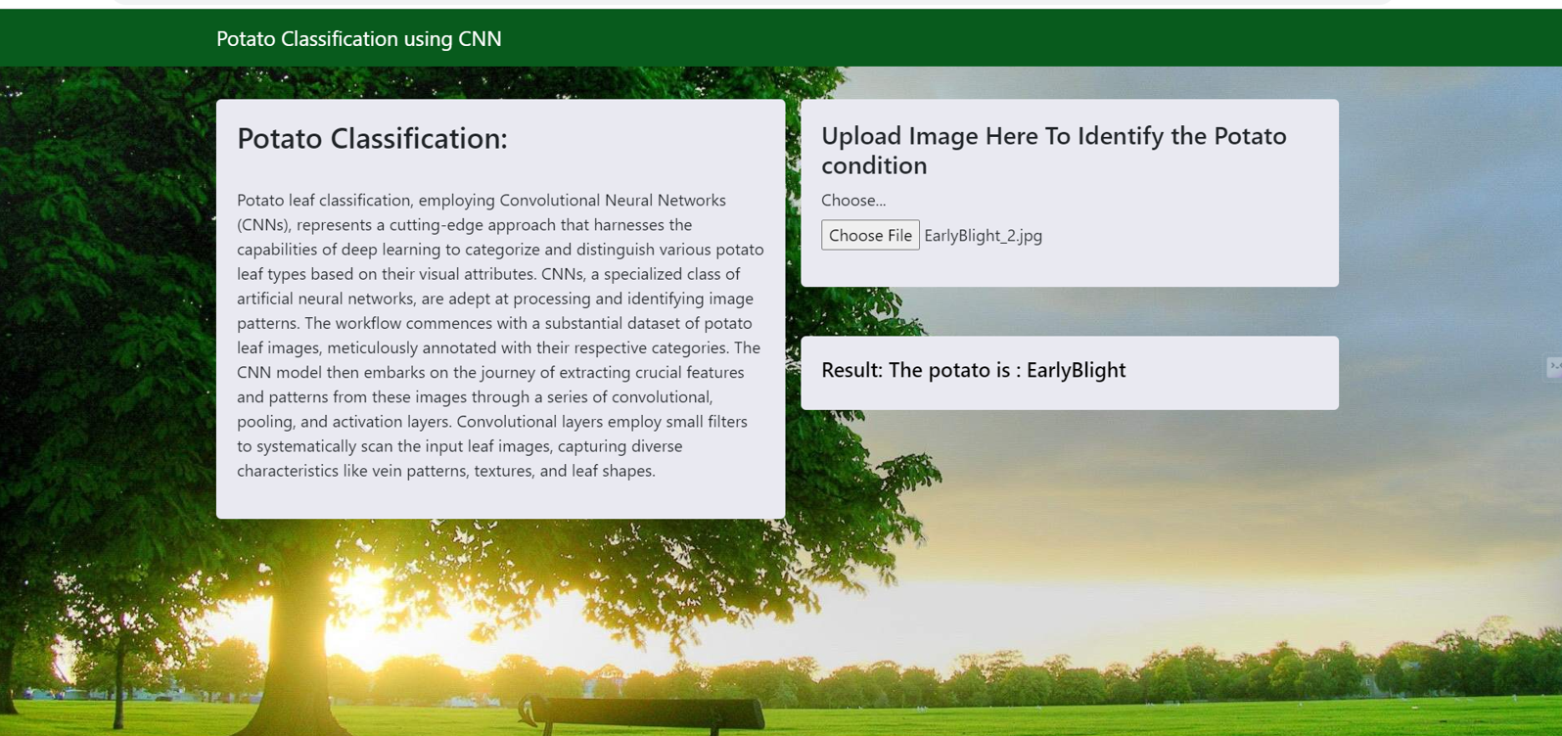
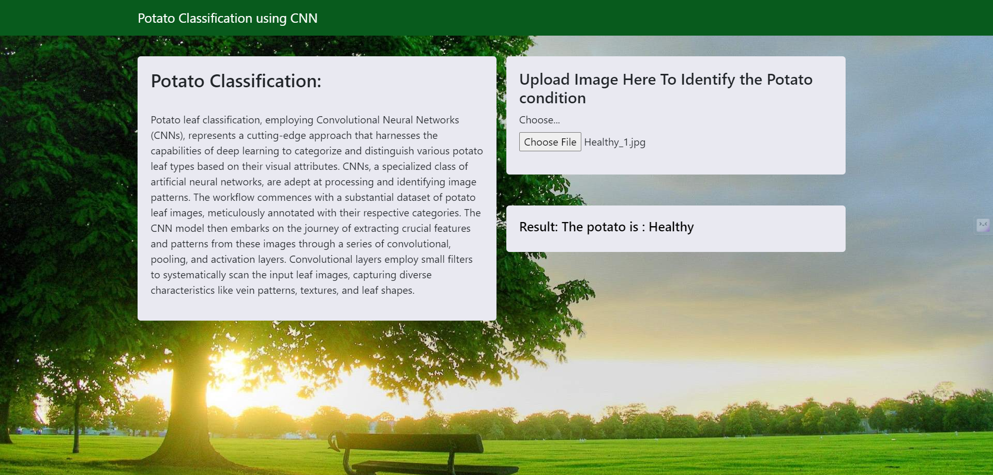

Outputs:
Leaf Types:
Early Blight
Late Blight
Healthy

Slide 32
Conclusion
The development of a potato disease classification system using deep learning, particularly Convolutional Neural Networks (CNNs), holds promise for agriculture by swiftly and accurately identifying diseases in potato plants, enabling early detection and thereby increasing crop yields, reducing economic losses, and enhancing food security. The system's user-friendly interface and feedback mechanisms ensure accessibility to a diverse user base, including non-technical users. However, challenges such as data quality, model complexity, interpretability, and ongoing maintenance must be carefully addressed to ensure effectiveness. Regular model updates and user feedback integration are crucial for maintaining accuracy and relevance over time. In conclusion, this project has the potential to significantly benefit farmers and the broader agricultural industry when implemented responsibly and thoughtfully.

Slide 33

Thank you

